Slide 1
MICRO PROJECT
MICROSOFT AZURE WEB SERVICE
Faculty Incharge: Dr. P. Anitha
Evaluator: Dr. T. Dhilipan Rajkumar
Department: Computer Science and Engineering (CSE)
Location: Krishnan Kovil - 6261262612
Kalasalingam Academy of Research and Education
DONE BY :
ANNAM HEMANTH KUMAR
99220041106

Slide 2
AGENDA
INTRODUCTION 3
Web Views 4
GOOGLE ANALYTICS 5
VISUAL STUDIO 6
AZURE 11

Slide 3
INTRODUCTION

Slide 4
Azure Web Services, part of Microsoft's Azure cloud computing platform, offers a comprehensive suite of services for building, deploying, and managing web applications and services. This platform-as-a-service (PaaS) offering provides developers with a scalable and flexible environment to develop, test, and host their applications without the need to manage underlying infrastructure. Here's a brief overview: Azure Web Services includes: Web App Service: Azure App Service enables developers to build and host web applications using various programming languages and frameworks such as .NET, Java, Python, Node.js, and PHP. It offers features like auto-scaling, continuous integration, and deployment, as well as integration with other Azure services.
WHY AZURE WEB SERVICE

Slide 5
Azure Functions: Azure Functions is a serverless compute service that enables developers to run code in response to events without managing server infrastructure. It supports a variety of programming languages and can be used for tasks such as data processing, file processing, and IoT device integration. Azure Static Web Apps: This service provides a modern approach to building and deploying static web applications. Developers can use popular frontend frameworks like React, Angular, and Vue.js, and leverage serverless APIs for backend functionality. Azure Static Web Apps also includes features like continuous deployment, custom domains, and authentication.
AZURE WEB SERVICE

Slide 6
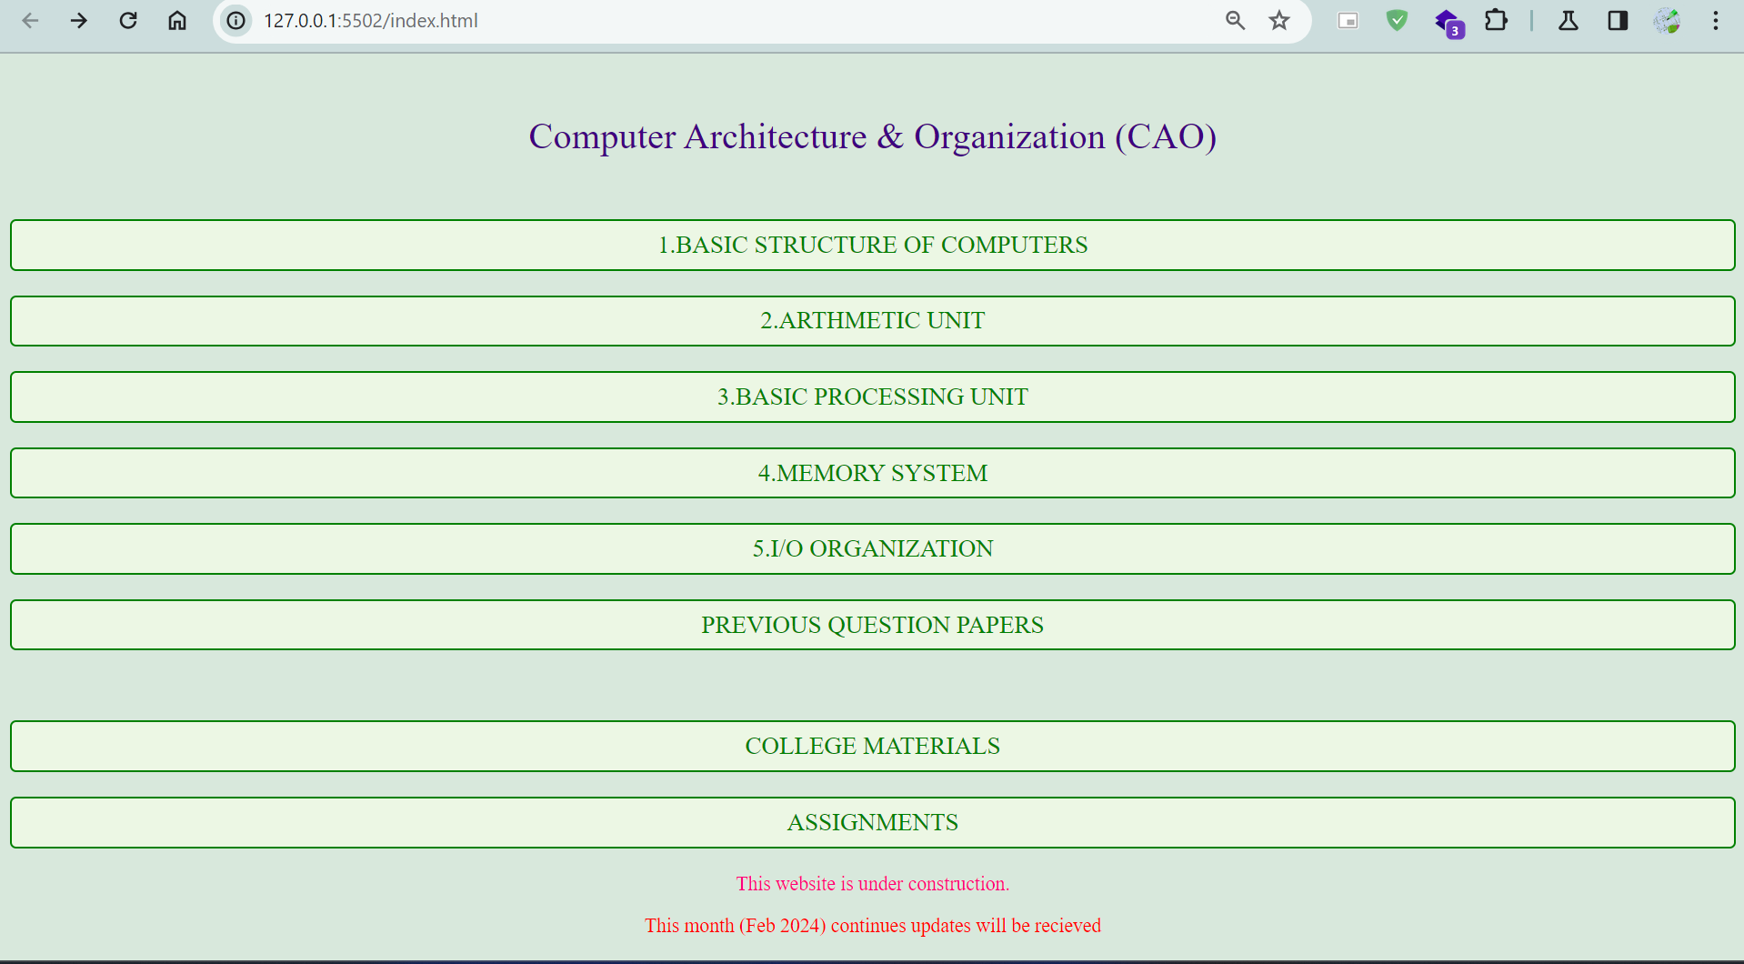
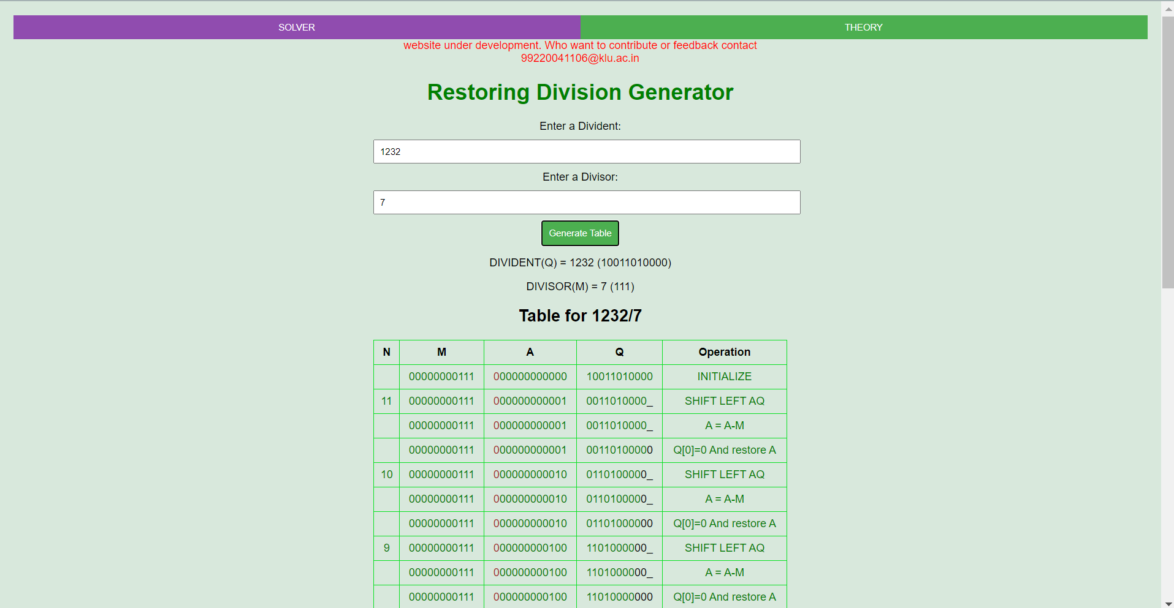
WEB VIEWS

Slide 7
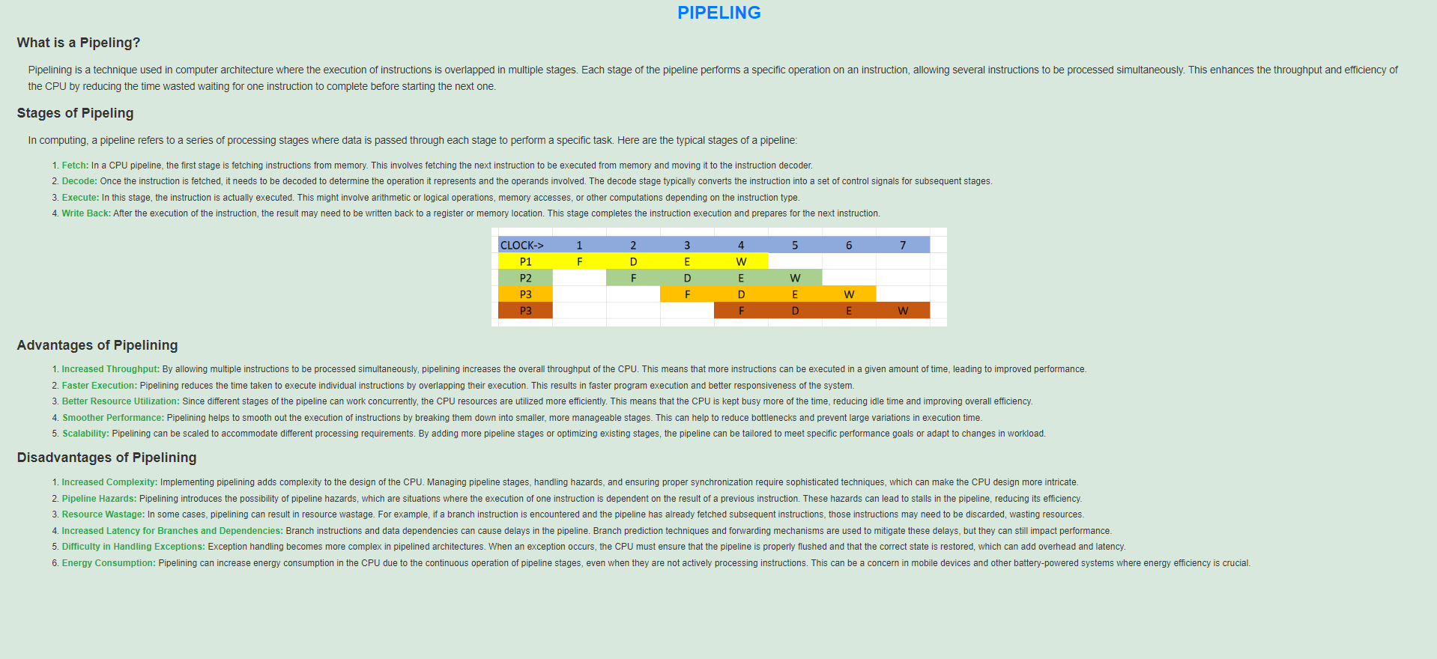
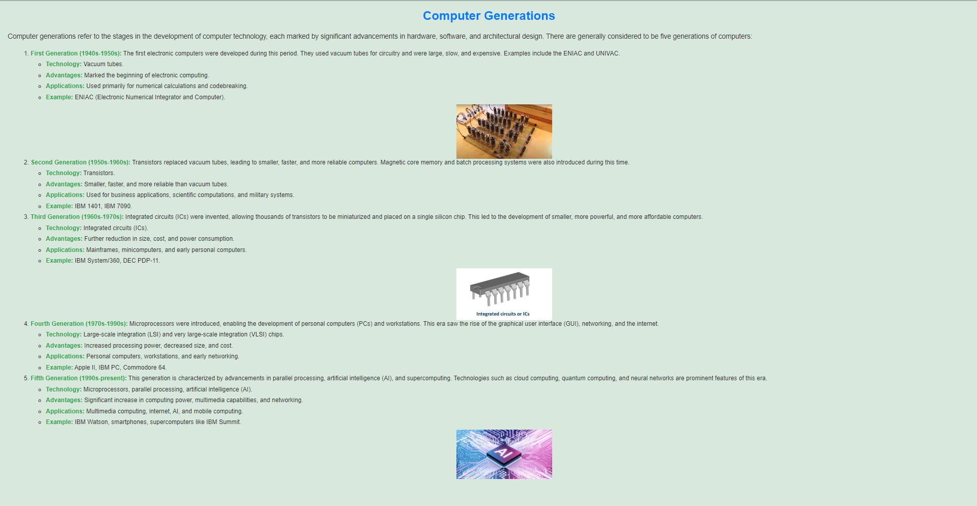
WEB VIEWS

Slide 8
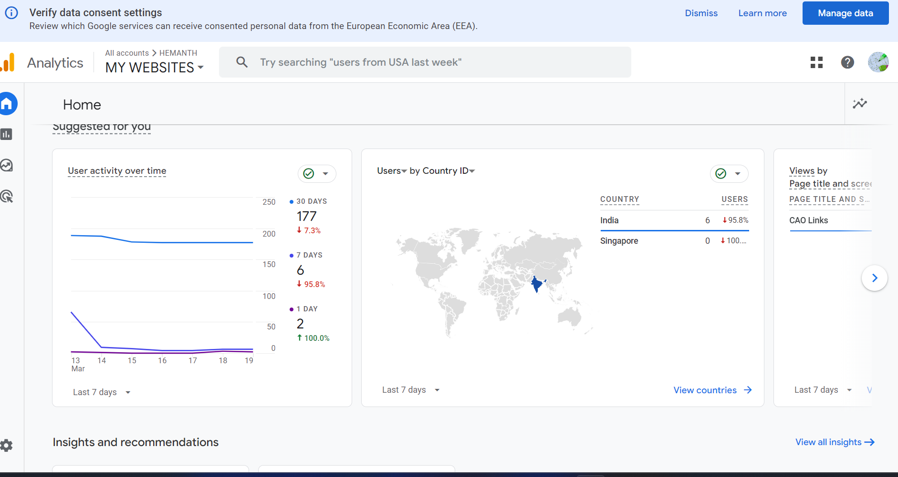
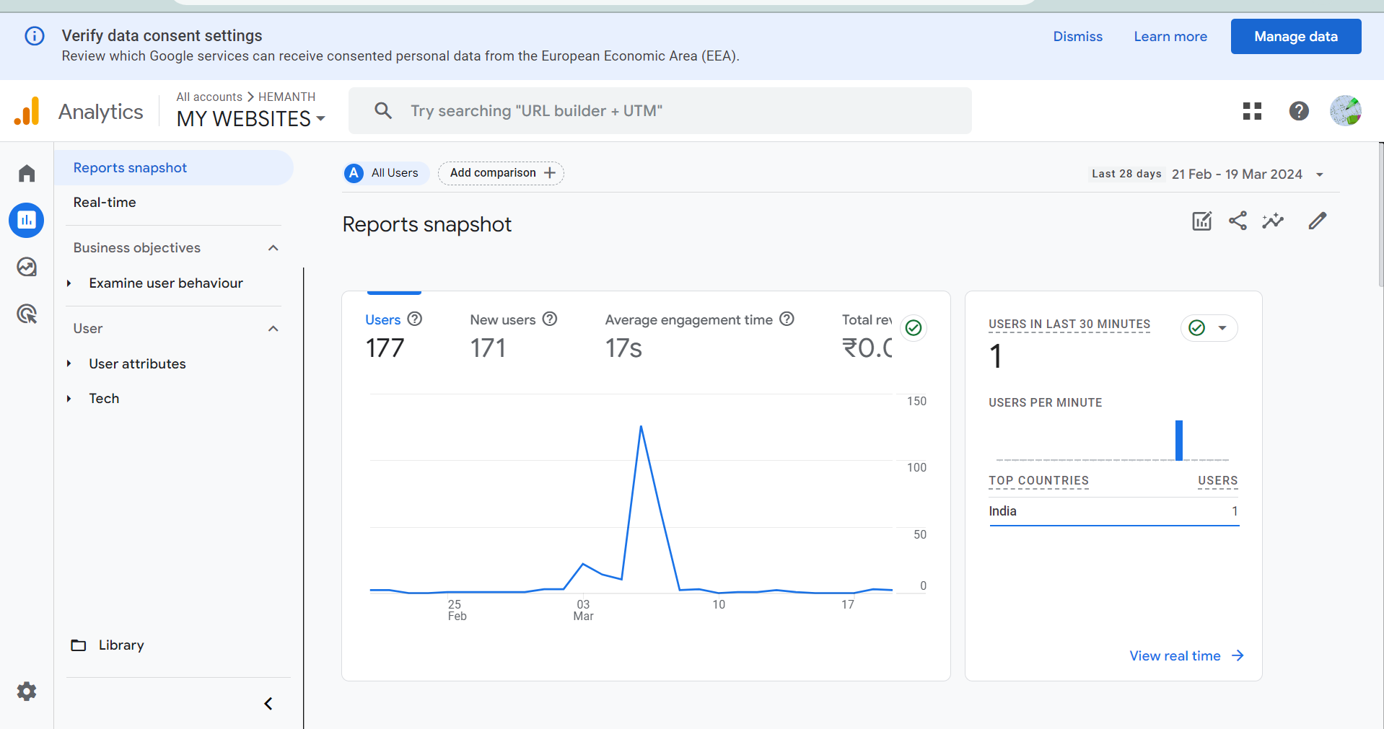
GOOGLE ANALYTICS

Slide 9
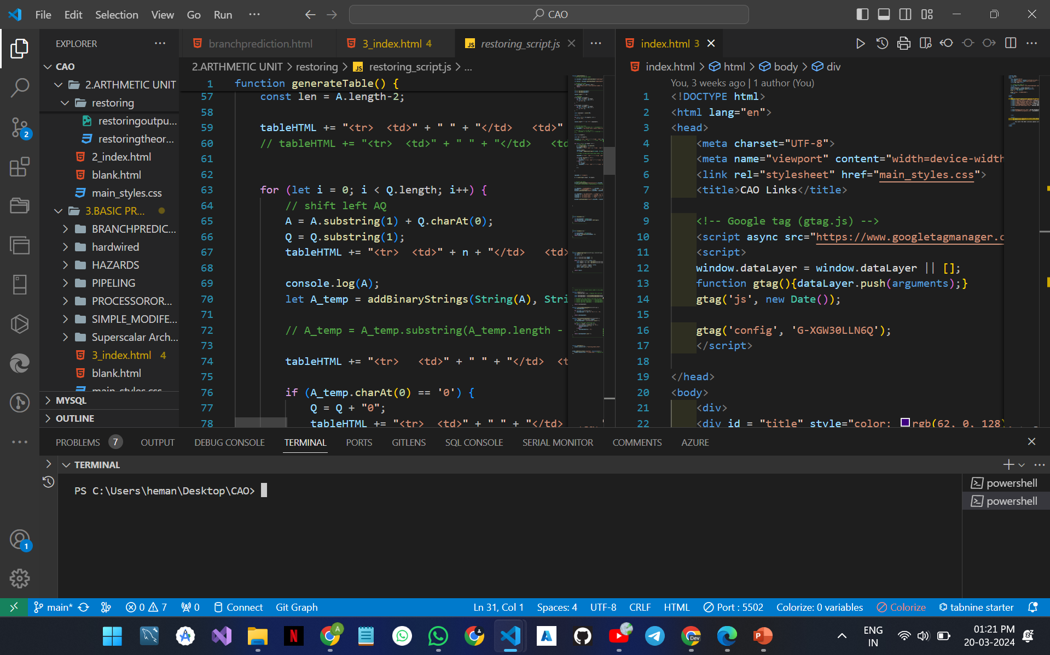
DEVELOPMENT SETUP

Slide 10
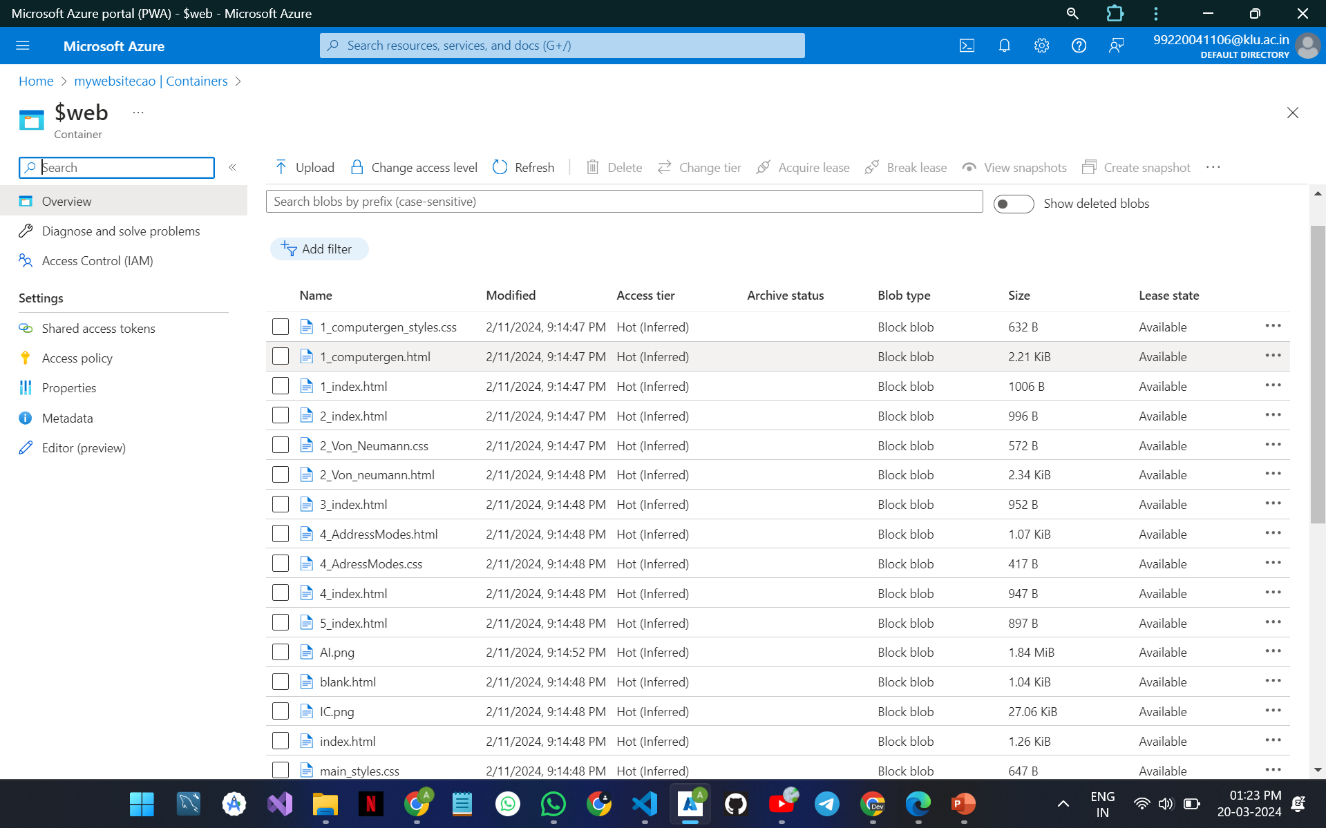
AZURE

Slide 11
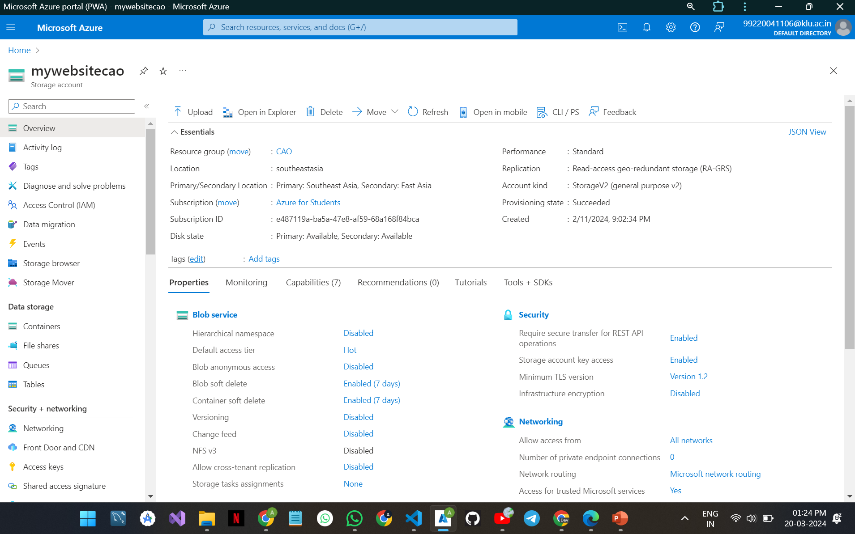
AZURE

Slide 12
1. AZURE WEB SERVICE 2. GOOGLE ANALYTICS 3.AZURE DATA STUDIO 4.VISUAL STUDIO CODE
REQUIREMENTS

Slide 13
THANK YOU

